Slide 1
Module 5 Getting Help

Slide 2
Exam Objective 2.2 Using the Command Line to Get Help
Objective Summary
Utilizing the man and info commands for finding more information

Slide 3
Introduction to the man command

Slide 4
man pages
Man pages are usually available for commands, functions or files
Man pages are available on the local system
Practice makes perfect!
Just as you practice executing Linux commands, you should practice reading man pages to become a more capable user

Slide 5
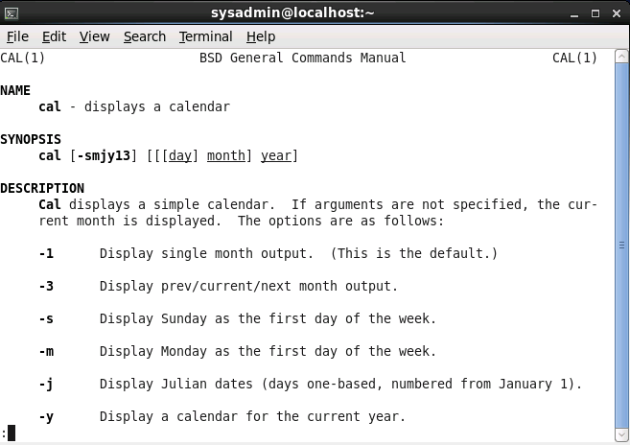
Viewing man pages
To vew a man page, first access a terminal or console and type man command or man file.

Slide 6
Controlling the man page display
The man page will be displayed by a pager program, either less or more (less is usually used).
Both pagers use h to view help, spacebar to move forward, / to start a search and q to quit.
Less movement commands:
Command | Function |  | Command | Function
Return (or Enter) | Go down one line |  | 1G | Go to beginning
Space | Go down one page |  | G | Go to end
/term | Search for term |  | h | Display help
n | Find next search item |  | q | Quit man page

Slide 7
Man page sections
The word sections has two important meanings for man pages.
Each man page is broken down under different section headings like NAME, SYNOPSIS and DESCRIPTION.
Every man page is categorized into a particular section like user commands, file formats, or system administration.

Slide 8
Common sections of a man page
Section name | Purpose
NAME | Provides the name of the command and a very brief description.
SYNOPSIS | Provides examples of how the command is executed. See below for more information.
DESCRIPTION | Provides a more detailed description of the command.
OPTIONS | Lists the options for the command as well as a description of how they are used. Often this information will be found in the DESCRIPTION section and not in a separate OPTIONS section.
FILES | Lists the file that are associated with the command as well as a description of how they are used.
AUTHOR | The name of the person who created the man page and (sometimes) how to contact the person.
REPORTING BUGS | Provides details on how to report problems with the command.
COPYRIGHT | Provides basic copyright information.
SEE ALSO | Provides you with an idea of where you can find additional information. This also will often include other commands that are related to this command.

Slide 9
Man pages SYNOPSIS
One of the most important sections on a man page is the SYNOPSIS.
The SYNOPSIS provides a concise description of the way the command can be used.
The square brackets, [ and ], are used to indicate optional items.
The vertical bar (|) indicates an exclusive or.
The ellipses (…) indicates one or more.

Slide 10
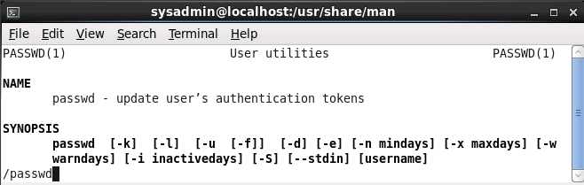
Searching within a man page
To initiate a search type /
Follow with the keyword to locate
Press Enter to view first match
Press n to view the next match
Press N to view the previous match

Slide 11
Sections and Sections

Slide 12
Man page sections
Man pages are placed into sections. There are nine standard sections:
Executable programs or shell commands
System calls (functions provided by the kernel)
Library calls (functions within program libraries)
Special files (usually found in /dev)
File formats and conventions, e.g. /etc/passwd
Games
Miscellaneous (including macro packages and conventions), e.g. man(7), groff(7)
System administration commands (usually only for root)
Kernel routines [Non standard]

Slide 13
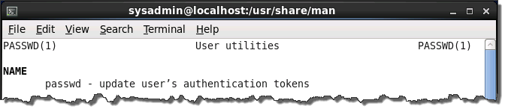
Determining which section
The section number of manual is enclosed in parentheses when viewing a man page.

Slide 14
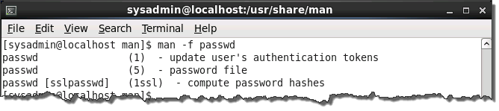
Searching the sections
To match man pages that have names that match a term, you can use the man command with the -f option.
The command whatis term is equivalent to the man -f term.

Slide 15
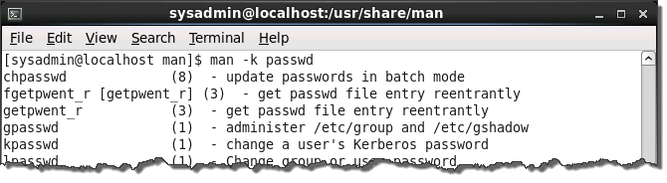
Searching man pages by keyword
The man command has an option, -k, which takes a keyword as an argument.
Executing man -k keyword, will search all the man pages descriptions for the keyword.
The apropos command is equivalent to using the man command with the -k option.

Slide 16
Specifying a section
If the command or file exists in more than one section of the manual, then it may be necessary to specify a manual section in order to view the correct man page.
For example, passwd is found in both sections 1 and 5. To view both passwd man pages, the following commands could be executed:
man 1 passwd
man 5 passwd

Slide 17
Using the info command

Slide 18
The info command
The info command provides documentation of commands and files similar to the man command
The info documentation is organized into different levels, each of which may contain one or more of the smallest units of organization: the node.
The info command will display a man page, as a fallback, in the absence of info documentation.

Slide 19
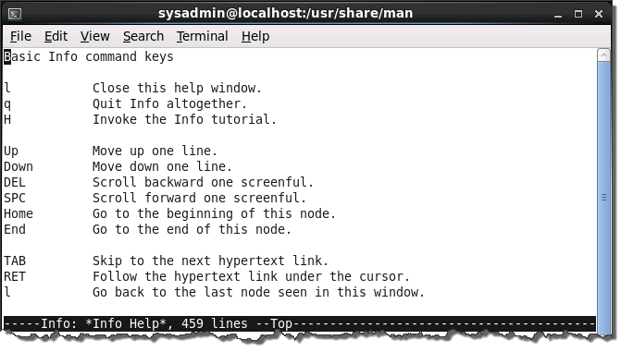
Displaying info documentation for a command
Press h to get help on using info:

Slide 20
Moving around while viewing an info document
The following table describes more commonly used keys to move within an info document:
Command | Function |  | Command | Function
Down arrow | Go down one line |  | TAB | Skip to next hyperlink
Space | Go down one page |  | HOME | Go to beginning
s | Search for term |  | END | Go to end
[ | Go to previous node |  | h | Display help
] | Go to next node |  | L | Quit help page
u | Go up one level |  | q | Quit info command

Slide 21
Exploring info documentation
Unlike man pages that are sometimes not very easy to read, the info pages are designed to be readable by regular people.
Consider executing simply info to begin reading the available info documentation.
You may also want to try using pinfo, a more colorful and easier to use version of info.

Slide 22
Getting Additional Help

Slide 23
Additional sources of help
The standard GNU option for documentation is --help. Use this to display basic command usage, which is similar to a man page.
Software often comes packaged with additional documentation that may be found under the /usr/doc or /usr/share/doc directory. These sub-directories often contain README files and other additional documentation.

Slide 24
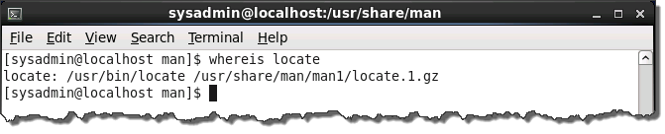
Finding commands and documentation
The whereis command will display the location of a command executable, as well as its source and documentation, if available.

Slide 25
Find any file or directory
The locate command is able to find any file as long as the user has permission to access the containing directory by searching a database of filenames on the system.
The updatedb command is typically scheduled to update the locate database daily, but the root user can execute updatedb to immediately update the locate database.

Slide 26
The locate command
The locate command will match any part of a filename, so locate readme could match a file named abcreadme123
The -b option for locate allows for a basename search, e.g.: locate -b readme
The -c option provides a count of the number of matching files: locate -c readme

